Slide 1
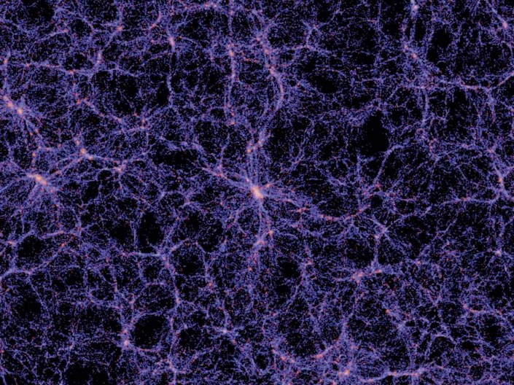
Refining Cosmology: Addressing Dark Energy Controversies Through a Novel non-Doppler Cosmological Redshift Model
Levon Tabirian
Trinity Preparatory School
IEEE Aerospace Conference 2019

Slide 2
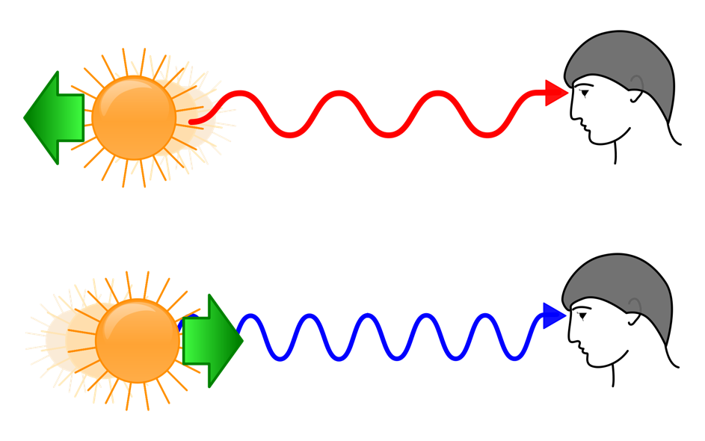
The Doppler Effect is considered the main cause of spectral redshifts:
Redshift are observed in spectra of distant astronomical objects

Slide 3
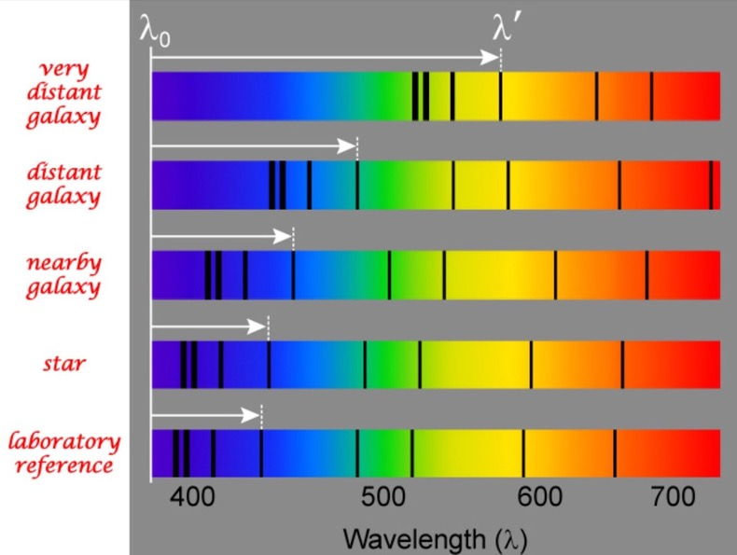
The Doppler Effect as an indicator of recessive velocity:
Hubble found the relationship between redshift and distance, and attributed it to the Doppler effect
v = H₀*d

Slide 4
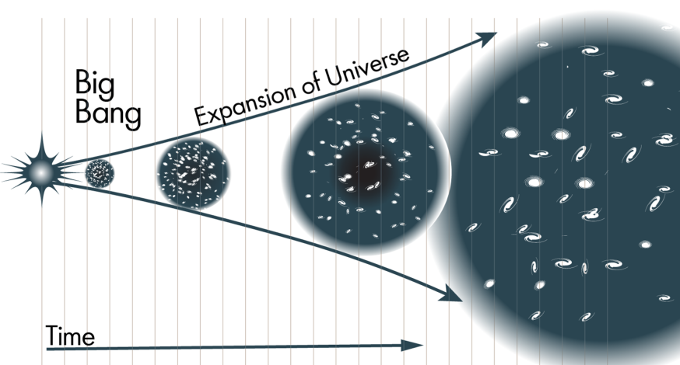
Distance-redshift relationship leads to expansion cosmology:
Far away objects have higher redshifts → Higher recessive velocity (due to Doppler Effect)
→ Accelerated Expansion at a rate given by H₀
→ ‘Dark energy’ powering expansion

Slide 5
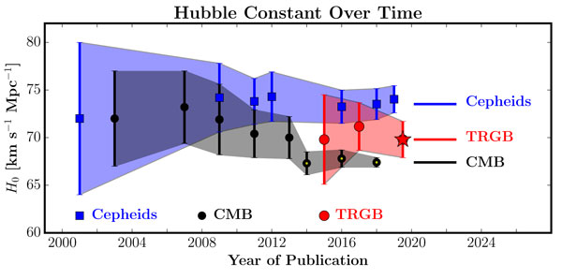
Problems coming to the surface?

Slide 6
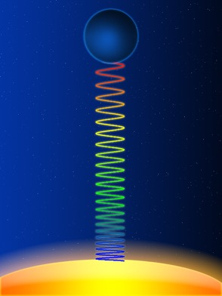
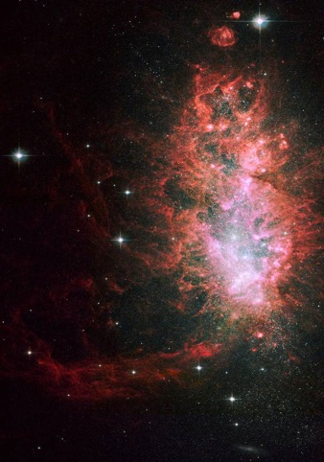
Can other natural phenomena cause a redshift?
Absolutely!
Example: Gravitational Redshifts
Problem: No explanation for redshift-distance relationship
Redshifts that can be applied to cosmological relationships:
‘Light deceleration’ induced redshifts
Light from distant objects is redshifted as it interacts with matter and propagates through an interstellar medium
‘Light deceleration’ previously observed through gravitational waves
Notes:
Interacts with interstellar medium

Slide 7
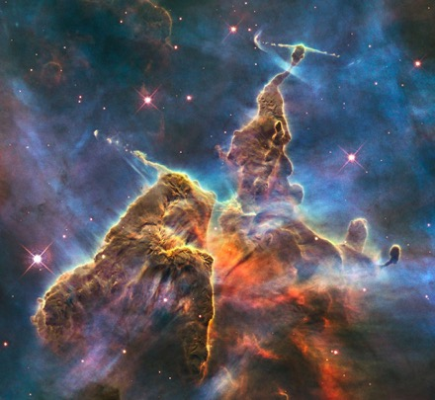
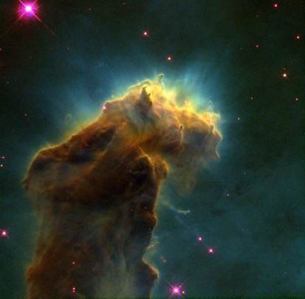
Explaining the Light Deceleration model:
All matter that light can propagate through has a refractive index
Refractive index is a numerical quantity that describes the new, slower speed of light as it passes through a specific medium
When light passes through a changing medium with a changing refractive index, a redshift is observed
Theoretically demonstrated!
Light is “decelerating” in dynamically changing matter
Carina Nebula
Eagle Nebula
Notes:
Stellar nursuries

Slide 8
Theory behind Light Deceleration redshifts:
Key assumption: speed of light changes as it propagates through space
Replace ‘c’ with $\frac{c}{n}$ (n is refractive index)
Derived Light Deceleration formula:
Hubble’s Law; based solely on observational data:
Both are naturally proportional to distance!
$\text{Φ}\text{ = }\text{ω}\text{t}\text{ − }\frac{\text{ω}}{n}$𝑥𝑐 ($\text{ω}$ - frequency, c - speed of light in a vacuum, n – refractive index)
$z=\frac{1}{c}\frac{∂n}{∂t}d$ (z - redshift, $\frac{∂n}{∂t}$ – change in refractive index over time, d – distance)
$z=\frac{H_{0}d}{c}$ ($H_{0}$- Hubble’s constant)

Slide 9
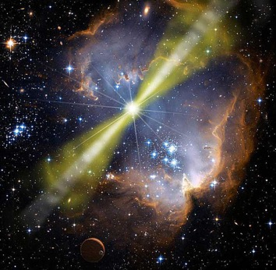
Finding discrepancies within Hubble’s Law:
NASA/IPAC Extragalactic Database
271,954 independent peer-reviewed distance measurements for 147,366 galaxies
Uniquely large-scale study of a variety of astronomical objects
Type 1a supernovae, gamma-ray bursts, Cepheids, RR Lyrae Variable Stars, etc.
Objective: Finding deviations from a linear redshift-distance relationship as predicted by Hubble
Type 1a SN remnant
GRB
Cepheid Variable
RR Lyrae Variable
Notes:
Almost crashed my computer

Slide 10
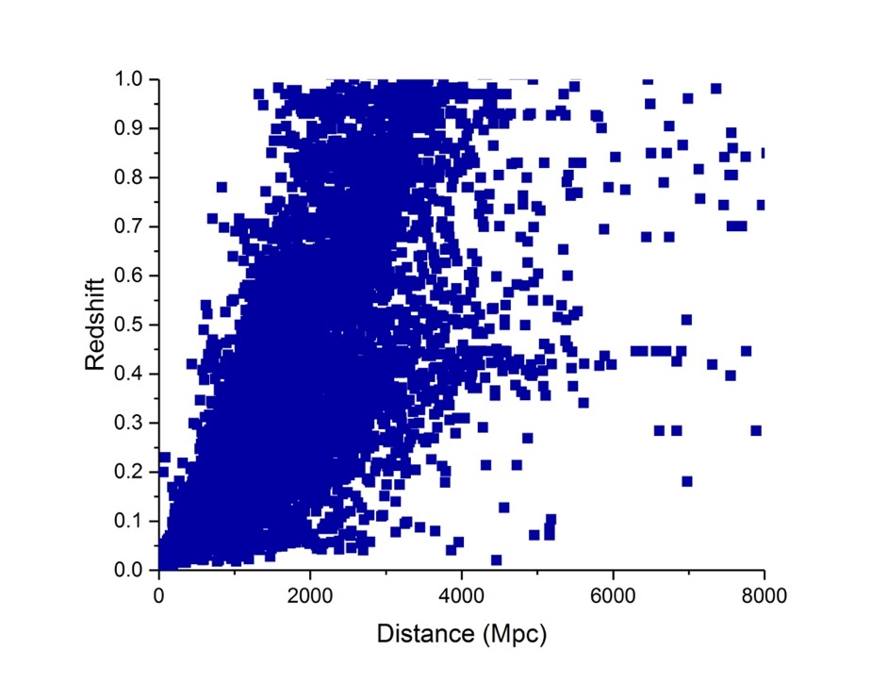
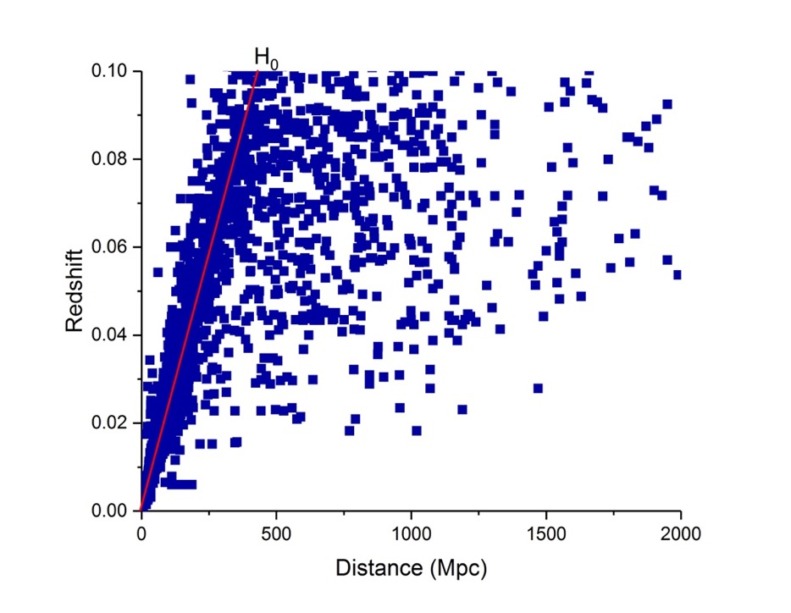
Analysis of redshift v. distance relationship:
Figure 1. Redshift-distance relationship of every object with a redshift-independent distance measurement.
Figure 2. Scaled Figure 1. with a red Hubble constant slope.
Notes:
Almost crashed my computer

Slide 11
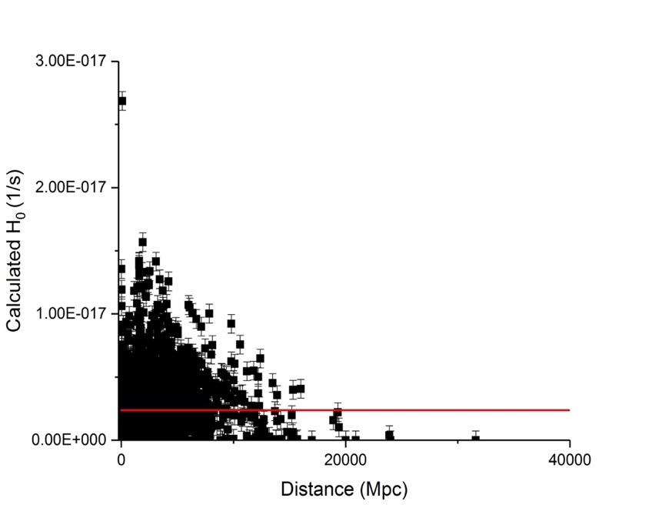
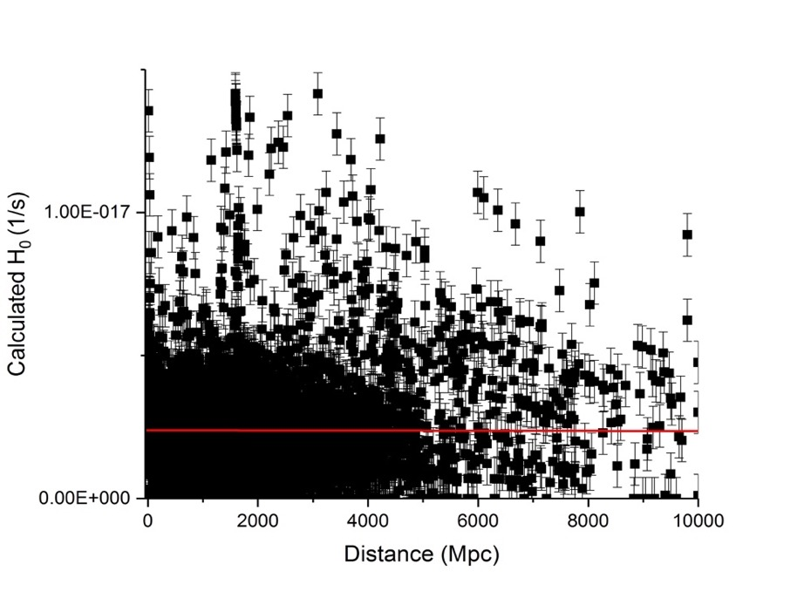
Discovery of thousands of Hubble’s Law redshift discrepancies:
Calculated H₀
Measured Hubble’s constant
Figure 3. A wide-scale image of all calculated Hubble constants in the NED database.
Figure 4. Thousands of astronomical objects fluctuate from a static H₀ .
Notes:
Almost crashed my computer

Slide 12
Closer analysis of controversial data:
Object Name | Redshift-Independent Comoving Radial Distance (Mpc) | Hubble-calculated Comoving Radial Distance (Mpc) | % Discrepancy
SN 13134 | 641 | 1981.6 | 209
SN 16144 | 692 | 1204.3 | 74
SN 13743 | 2290 | 830.1 | 176
SN 18694 | 3360 | 1288.2 | 161
SN 07496 | 990 | 2076.9 | 110
SN 17068 | 597 | 1170.9 | 96
COMBO-17 40328 | 1150 | 4241.5 | 269
SN 10641 | 4160 | 2189.0 | 90
Future Investigation: An telescopic analysis of media surrounding these SNe
Notes:
Few examples

Slide 13
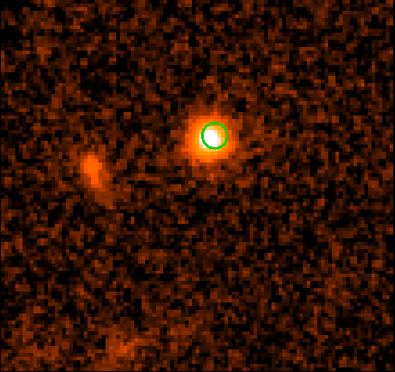
Addressing the controversies with the LD Model:
Objects don’t have to conform to a perfectly linear model!
Different astronomical objects have different circumstances surrounding the medium their light propagates in during its journey to Earth
Key example of GRB 970828:
Redshift-Independent distance: 2100 Mpc
Redshift calculated distance: 4000 Mpc
Emission of GRB described as an environment ‘with a large average particle density and dense clouds’
Izzo, L., Ruffini, R., Bianco, C., Dereli, H., Muccino, M., Penacchioni, A., Pisani, G., & Rueda, J. A. (2012). On the thermal and double episode emissions in GRB 970828.
55% discrepancy!
GRB 970828
Notes:
Unusually larges changes in refractive index → unusually large redshift
55% falls far away from the margin of error
Precisely environment which would produce an exaggerated redshift compared to distance

Slide 14
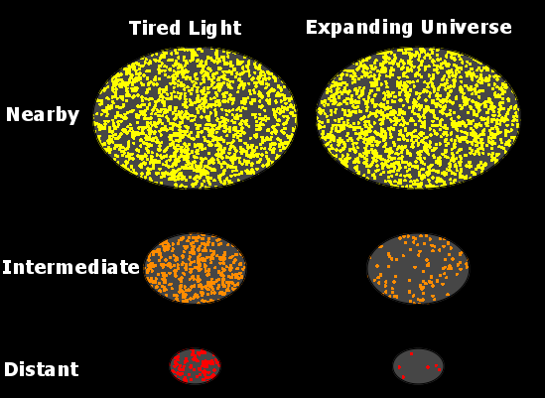
Reconciling differences with ‘Tired Light’ models:
Previous non-Doppler redshift models have been largely discredited
Significant difference: no light-scattering redshift mechanism
Potential problems:
Absence of observed blurring
Type 1a SNe relativistic light curves
Tolman surface brightness test

Slide 15
Discussion:
Modern cosmology lacks a major discovery to reconcile experimental data with theoretical dark energy predictions
A complete justification of non-Doppler redshifts as the singular cause of cosmological redshifts is not currently feasible
However, there is ample evidence supporting the existence of non-Doppler, LD redshifts in conjunction with dominant Doppler redshifts
If confirmed, the current abundance of dark energy is vastly overestimated!

Slide 16
References:
Rusu, C. E., Berghea, C. T., Fassnacht, C. D., More, A., Seman, E., Nelson, G. J., & Chen, G. C.-F. (2019). A search for gravitationally lensed quasars and quasar pairs in Pan-STARRS1: spectroscopy and sources of shear in the diamond 2M1134−2103. Monthly Notices of the Royal Astronomical Society, 486(4), 4987–5007. https://doi.org/10.1093/mnras/stz1142
Freedman, W. L., Madore, B. F., Gibson, B. K., Ferrarese, L., Kelson, D. D., Sakai, S., Mould, J. R., Kennicutt, J., Robert C., Ford, H. C., Graham, J. A., Huchra, J. P., Hughes, S. M. G., Illingworth, G. D., Macri, L. M., & Stetson, P. B. (2001). Final Results from theHubble Space TelescopeKey Project to Measure the Hubble Constant. The Astrophysical Journal, 553(1), 47–72. https://doi.org/10.1086/320638
Kirshner, R. P. (2004). Hubble’s diagram and cosmic expansion. Proceedings of the National Academy of Sciences, 101(1), 8. https://doi.org/10.1073/pnas.2536799100
López-Corredoira, M. (2017). Tests and Problems of the Standard Model in Cosmology. Foundations of Physics, 47(6), 711–768. https://doi.org/10.1007/s10701-017-0073-8
LIGO Scientific Collaboration and Virgo Collaboration, Abbott, B. P., Abbott, R., Abbott, T. D., Acernese, F., Ackley, K., Adams, C., Adams, T., Addesso, P., Adhikari, R. X., Adya, V. B., Affeldt, C., Afrough, M., Agarwal, B., Agathos, M., Agatsuma, K., Aggarwal, N., Aguiar, O. D., Aiello, L., … Zweizig, J. (2017). GW170817: Observation of Gravitational Waves from a Binary Neutron Star Inspiral. Physical Review Letters, 119(16), 161101. https://doi.org/10.1103/PhysRevLett.119.161101
Colin, J., Mohayaee, R., Rameez, M., & Sarkar, S. (2019). Evidence for anisotropy of cosmic acceleration⋆. A&A, 631. https://doi.org/10.1051/0004-6361/201936373
Tabirian, L. N. (2019). Addressing redshift controversies through the doppler analog of spectral redshifts caused by light deceleration in dynamic media. Optik, 183, 723–726. https://doi.org/10.1016/j.ijleo.2019.02.150
Ferrière, K. M. (2001). The interstellar environment of our galaxy. Reviews of Modern Physics, 73(4), 1031–1066. https://doi.org/10.1103/RevModPhys.73.1031
Steer, I., Madore, B. F., Mazzarella, J. M., Schmitz, M., Corwin, H. G., Chan, B. H. P., Ebert, R., Helou, G., Baker, K., Chen, X., Frayer, C., Jacobson, J., Lo, T., Ogle, P., Pevunova, O., & Terek, S. (2016). REDSHIFT-INDEPENDENT DISTANCES IN THE NASA/IPAC EXTRAGALACTIC DATABASE: METHODOLOGY, CONTENT, AND USE OF NED-D. The Astronomical Journal, 153(1), 37. https://doi.org/10.3847/1538-3881/153/1/37
Wang, L., Höflich, P., & Wheeler, J. C. (1997). Supernovae and Their Host Galaxies. The Astrophysical Journal, 483(1), L29–L32. https://doi.org/10.1086/310737
Wright, E. L. (2006). A Cosmology Calculator for the World Wide Web. Publications of the Astronomical Society of the Pacific, 118(850), 1711–1715. https://doi.org/10.1086/510102
Castro-Tirado, A. J., Sokolov, V. V., Gorosabel, J., Castro Cerón, J. M., Greiner, J., Wijers, R. A. M. J., Jensen, B. L., Hjorth, J., Toft, S., Pedersen, H., Palazzi, E., Pian, E., Masetti, N., Sagar, R., Mohan, V., Pandey, A. K., Pandey, S. B., Dodonov, S. N., Fatkhullin, T. A., … Hurley, K. (2001). The extraordinarily bright optical afterglow of GRB 991208 and its host galaxy. A&A, 370(2), 398–406. https://doi.org/10.1051/0004-6361:20010247
Pastorello, A., Turatto, M., Benetti, S., Cappellaro, E., Danziger, I. J., Mazzali, P. A., Patat, F., Filippenko, A. V., Schlegel, D. J., & Matheson, T. (2002). The type IIn supernova 1995G: interaction with the circumstellar medium. Monthly Notices of the Royal Astronomical Society, 333(1), 27–38. https://doi.org/10.1046/j.1365-8711.2002.05366.x
Gorosabel, J. et al. “A Multi-Colour Study of the Dark GRB 000210 Host Galaxy and Its Environment.” Astronomy & Astrophysics 400.1 (2003): 127–136. Crossref. Web.
Ruiz‐Velasco, A. E., Swan, H., Troja, E., Malesani, D., Fynbo, J. P. U., Starling, R. L. C., Xu, D., Aharonian, F., Akerlof, C., Andersen, M. I., Ashley, M. C. B., Barthelmy, S. D., Bersier, D., Ceron, J. M. C., Castro‐Tirado, A. J., Gehrels, N., Goğuş, E., Gorosabel, J., Guidorzi, C., … Zheng, W. K. (2007). Detection of GRB 060927 atz= 5.47: Implications for the Use of Gamma‐Ray Bursts as Probes of the End of the Dark Ages. The Astrophysical Journal, 669(1), 1–9. https://doi.org/10.1086/521546
Izzo, L., Ruffini, R., Bianco, C., Dereli, H., Muccino, M., Penacchioni, A., Pisani, G., & Rueda, J. A. (2012). On the thermal and double episode emissions in GRB 970828.
Lubin, L. M., & Sandage, A. (2001). The Tolman Surface Brightness Test for the Reality of the Expansion. IV. A Measurement of the Tolman Signal and the Luminosity Evolution of Early-Type Galaxies. The Astronomical Journal, 122(3), 1084–1103. https://doi.org/10.1086/322134
Blondin, S., Davis, T. M., Krisciunas, K., Schmidt, B. P., Sollerman, J., Wood‐Vasey, W. M., Becker, A. C., Challis, P., Clocchiatti, A., Damke, G., Filippenko, A. V., Foley, R. J., Garnavich, P. M., Jha, S. W., Kirshner, R. P., Leibundgut, B., Li, W., Matheson, T., Miknaitis, G., … Zenteno, A. (2008). Time Dilation in Type Ia Supernova Spectra at High Redshift. The Astrophysical Journal, 682(2), 724–736. https://doi.org/10.1086/589568
Ming-Hui Shao. (2019). Tired Light Denies the Big Bang. In Na Wang (Ed.), Redefining Standard Model Cosmology (p. Ch. 2). IntechOpen. https://doi.org/10.5772/intechopen.81233

